Slide 1
CENT
The Center for Emerging Network Technologies

Slide 2
Mission
To provide a platform for faculty research on digital convergence and networking
To provide experiential learning for graduate and advanced undergraduate student teams
To serve as a mutually beneficial learning interface between the networking technology industries and the School of Information Studies

Slide 3
CENT
An initiative by School of Information Studies
To perform research and development on network system technologies and applications
To provide hands-on learning opportunities to iSchool students
Previously named CCENT (2009-2017)

Slide 4
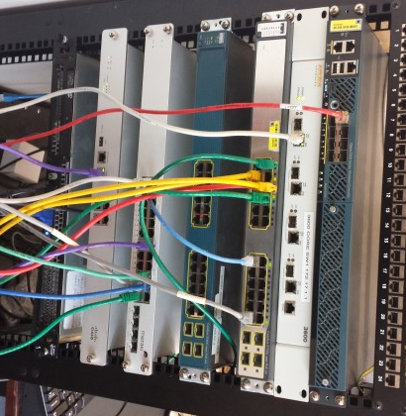
Current Focus Areas
Internet of Things (IoT)
Enterprise Networking
Wireless Networking
Network Security
Enterprise Data Systems
RF Spectrum Management

Slide 5
Past Members

Slide 6
Current Projects
Internet of Things – The iSchool “living” lab
Big data infrastructure setup
OpenStack
RancherOS
Containers
Mobile app for sleep study
iSchool & Psychology collaboration
The Spectrum Consumption Model Builder and Analysis Tool (SCMBAT)

Slide 7
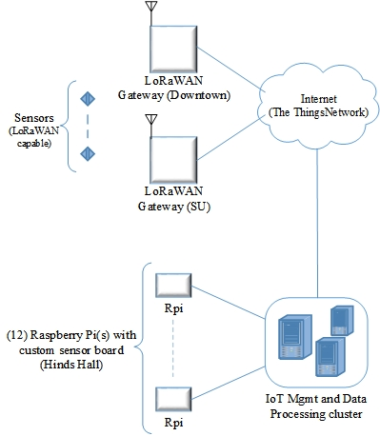
Current Projects - IoT
The iSchool “living” lab

Slide 8
Past Research
IPv6
Security
Virtualization
Deep Packet Inspection
Unified Communication
Wireless Communication

Slide 9
Technical Reports
IPv6 Security Analysis
Study of IPv6 Security Vulnerabilities
(J. Bejar and C. Caicedo)
(Anirudh Nagesh, Keshav Khandelwal and Carlos Caicedo)

Slide 10
For further information
Visit our website!
http://ccent.syr.edu

