Slide 1

CENT
The Center for Emerging Network Technologies

Slide 2
test

Slide 3
Mission
To provide a platform for faculty research on digital convergence and networking
To provide experiential learning for graduate and advanced undergraduate student teams
To serve as a mutually beneficial learning interface between the networking technology industries and the School of Information Studies

Slide 4
CENT
An initiative by School of Information Studies
  To perform research and development on network system technologies and applications
  To provide hands-on learning opportunities to iSchool students
  Previously named CCENT (2009-2017)

Slide 5
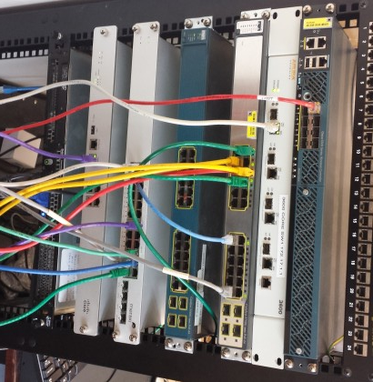
Current Focus Areas
Internet of Things (IoT)
Enterprise Networking
Wireless Networking
Network Security
Enterprise Data Systems
RF Spectrum Management

Slide 6
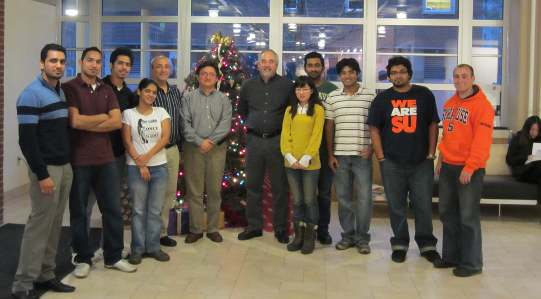
Past Members

Slide 7
Current Projects
Internet of Things – The iSchool “living” lab
Big data infrastructure setup
  OpenStack
  RancherOS
  Containers
Mobile app for sleep study
  iSchool & Psychology collaboration
The Spectrum Consumption Model Builder and Analysis Tool (SCMBAT)

Slide 8
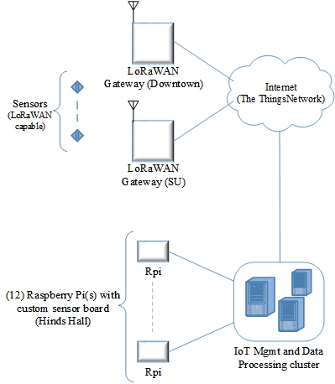
Current Projects - IoT
(The iSchool “living” lab)

Slide 9


Past Research
IPv6
Security
Virtualization
Deep Packet Inspection
Unified Communication
Wireless Communication

Slide 10
Technical Reports
IPv6 Security Analysis
(J. Bejar and C. Caicedo)
Study of IPv6 Security Vulnerabilities
  (Anirudh Nagesh, Keshav Khandelwal and Carlos Caicedo)

Slide 11
For further information
CENT/CCENT website
  ccent.syr.edu

