Slide 1

CENT
The Center for Emerging Network Technologies

Slide 2
Mission
To provide a platform for faculty research on digital convergence and networking
To provide experiential learning for graduate and advanced undergraduate student teams
To serve as a mutually beneficial learning interface between the networking technology industries and the School of Information Studies

Slide 3
CENT
An initiative by School of Information Studies
  To perform research and development on network system technologies and applications
  To provide hands-on learning opportunities to iSchool students
  Previously named CCENT (2009-2017)

Slide 4
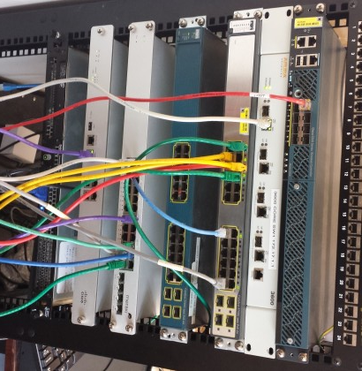
Current Focus Areas
Internet of Things (IoT)
Enterprise Networking
Wireless Networking
Network Security
Enterprise Data Systems
RF Spectrum Management

Slide 5
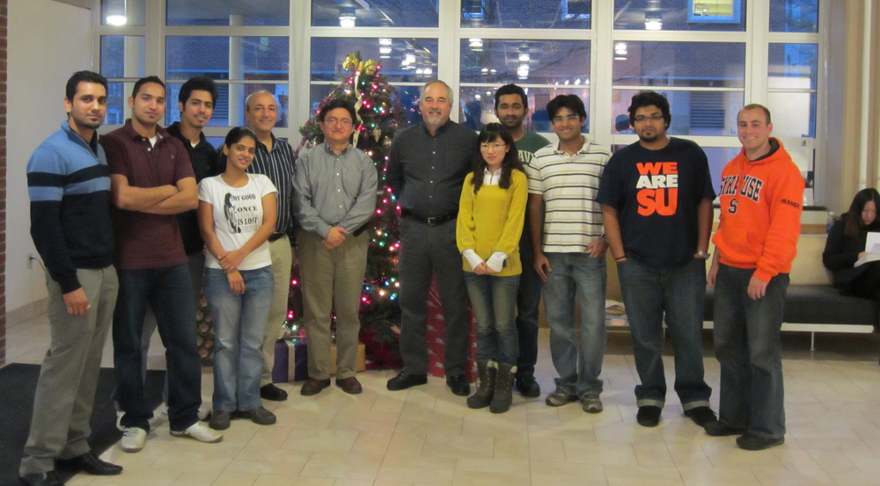
Past Members

Slide 6
Current Projects
Internet of Things – The iSchool “living” lab
Big data infrastructure setup
  OpenStack
  RancherOS
  Containers
Mobile app for sleep study
  iSchool & Psychology collaboration
The Spectrum Consumption Model Builder and Analysis Tool (SCMBAT)

Slide 7
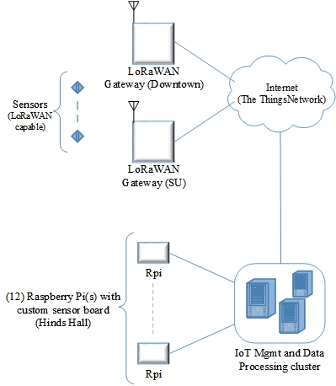
Current Projects - IoT
(The iSchool “living” lab)

Slide 8


Past Research
IPv6
Security
Virtualization
Deep Packet Inspection
Unified Communication
Wireless Communication

Slide 9
Technical Reports
IPv6 Security Analysis
(J. Bejar and C. Caicedo)
Study of IPv6 Security Vulnerabilities
  (Anirudh Nagesh, Keshav Khandelwal and Carlos Caicedo)

Slide 10
For further information
CENT/CCENT website
  ccent.syr.edu

Slide 12
CENT
Contribute to the development and study of computer network technologies
Exchange ideas, projects and technology
Promote use of new technologies

Slide 13

Wireless Networking
802.11ac WLANs
Wireless WANs
WiMAX

Slide 14
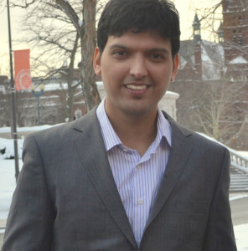





Past Members

Slide 15
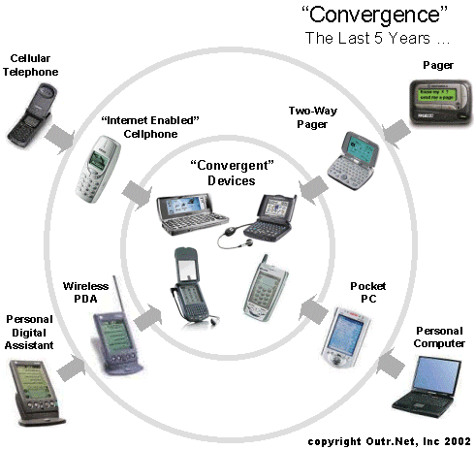
“Digital Convergence”
Emergence of digital technologies
Represent, store and communicate information.
Grow
  Interactivity
  Interoperability
  Connectedness

Slide 16
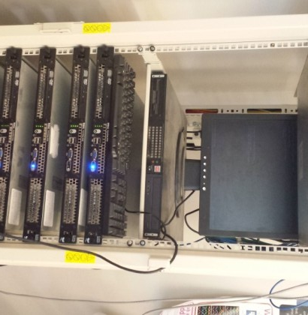
Enterprise Networking
WAN Optimization
Network Access Control
10G Ethernet
Carrier Ethernet

Slide 17

Mission Statement
Understand the future of networking technologies
  Engage in the process of defining and shaping the future of networking technoogies with
  Students
  Faculty
  Industry

Slide 18


Unified Communication
VOIP
SIP
Fixed Mobile Convergence

Slide 19

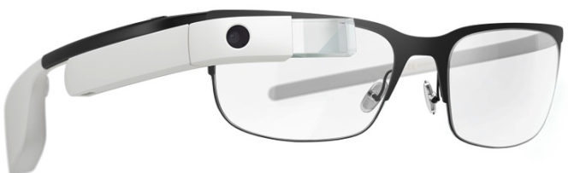
Mobile Applications
Google Glass Development
Android
  Google Maps
  HTML5, CSS
  JavaScript

Slide 20


Latest Blogs
Craig Mathias Visits CCENT
Internet Protocol Version 6 (IPv6)
Please visit http://ccent.syr.edu/blogs/

