Slide 1


CCENT
The Center for Convergence and Emerging Network Technologies

Slide 2
CCENT
Contribute to networking technologies
Exchange ideas, projects and technology
Discussions with the community
Promote use of new technologies.

Slide 3
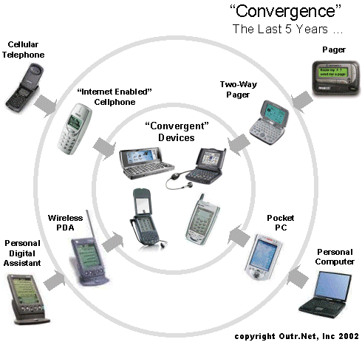
“Digital Convergence”
Emergence of digital technologies
Represent, store and communicate information.
Grow
  Interactivity
  Interoperability
  Connectedness

Slide 4

CCENT
An initiative by School of Information Studies
To research on how inter-operable systems
To provide solutions for industries and economies.

Slide 5
Main Focus
To research on upcoming technologies
To identify where it fits in at the level of enterprise technological architecture.
To create a culture of knowledge management

Slide 6

Mission Statement
Understand the future of networking technologies
  Engage in the process of defining and shaping future with
  Students
  Faculty
  Industry

Slide 7
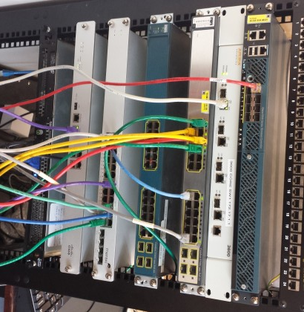
Current Focus Areas
Enterprise Networking
Wireless Networking
Network Security
Unified Communication
Mobile Applications

Slide 8
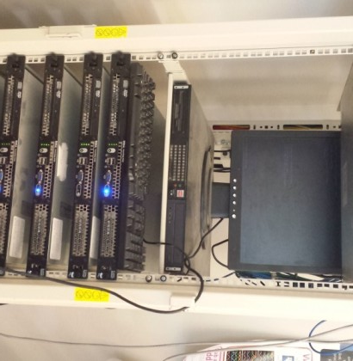
Enterprise Networking
WAN Optimization
Network Access Control
10G Ethernet
Carrier Ethernet

Slide 9

Wireless Networking
802.11ac WLANs
Wireless WANs
WiMAX

Slide 10


Unified Communication
VOIP
SIP
Fixed Mobile Convergence

Slide 11


Mobile Applications
Google Glass Development
Android
  Google Maps
  HTML5, CSS
  JavaScript

Slide 12
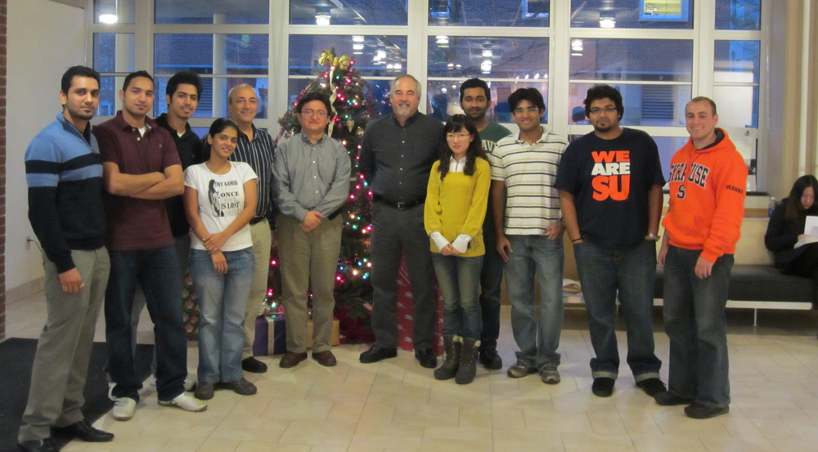
Past Members

Slide 13
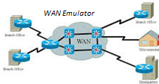

Current Projects
Managing a network using SNMPv3
Implementation of a WAN emulator
Configuration of a SIP Trunk
Implementing Network using Juniper

Slide 14


Past Research
IPv6
Security
Virtualization
Deep Packet Inspection
Unified Communication
Wireless Communication
Network Lab Virtualization Project

Slide 15


Latest Blogs
Craig Mathias Visits CCENT
Internet Protocol Version 6 (IPv6)
Please visit http://ccent.syr.edu/blogs/

Slide 16
Technical Reports
IPv6 Security Analysis
(J. Bejar and C. Caicedo)
Study of IPv6 Security Vulnerabilities
  (Anirudh Nagesh, Keshav Khandelwal and Carlos Caicedo)

Slide 17
Policy Reports & Publications
Reinventing Media Activism: Public Interest Advocacy in the Making of U.S. Communication-Information Policy,1960-2002
(Milton L. Mueller, Brenden Kuerbis and Christiane Page, July 2004)
Making Sense of Internet Governance: Defining Principles and Norms in a Policy Context
  (Milton L. Mueller, John Mathiason and Lee McKnight, April 2004)
The Post-COM Internet: A Five-Step Process for Top-Level Domain Additions.
(Milton L. Mueller and Lee McKnight, March 2003)
Success by Default: A New profile of Domain Name Trademark Disputes under ICANN’s UDRP
(Milton L. Mueller, June 2002)
Rough Justice: An Analysis of ICANNN’s Uniform Dispute Resolution Policy
(Milton L. Mueller, November 2000)

