Slide 1
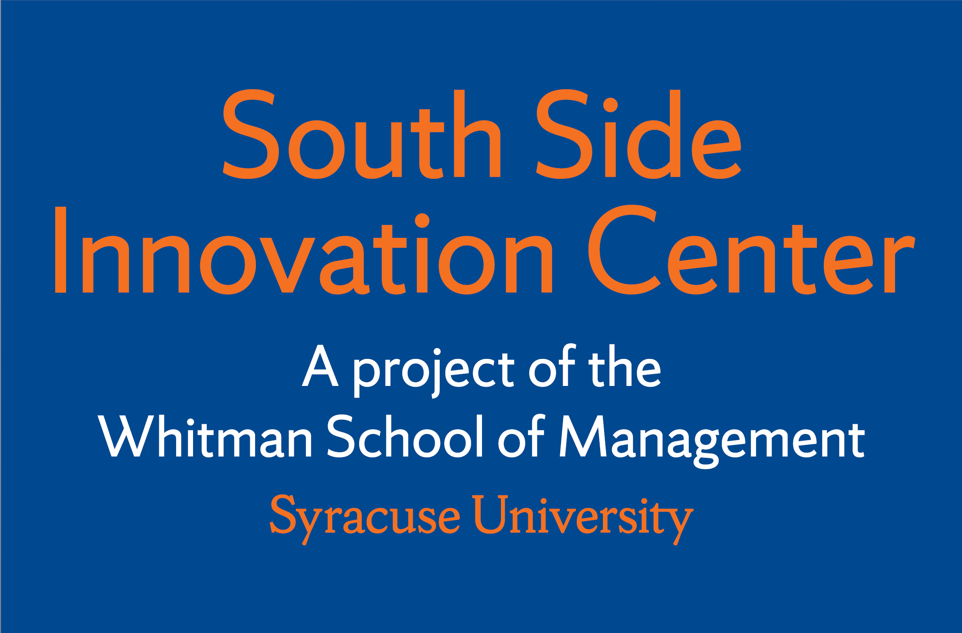
Southside Innovation Center
A project of the
Whitman School of Management
Syracuse University

