Slide 43
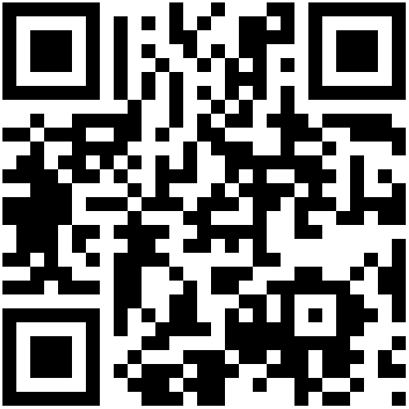
AWS Cloud Foundations Course
Non-credit course.
Work towards your AWS Cloud Practitioner certification!
No experience necessary
Everyone is welcome.
Signup deadline is Sep 8th
To Learn More Or Sign Up
http://bit.do/aws21

