Slide 1
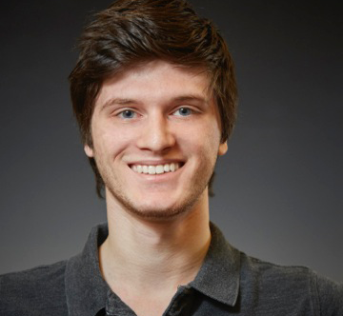
College: iSchool
Major: Information Management & Technology
Year: Junior
About
NEXIS Designer
Create all official NEXIS graphics and media
Currently Working On
Redesigning Logo
Kyle
Rand

Slide 2
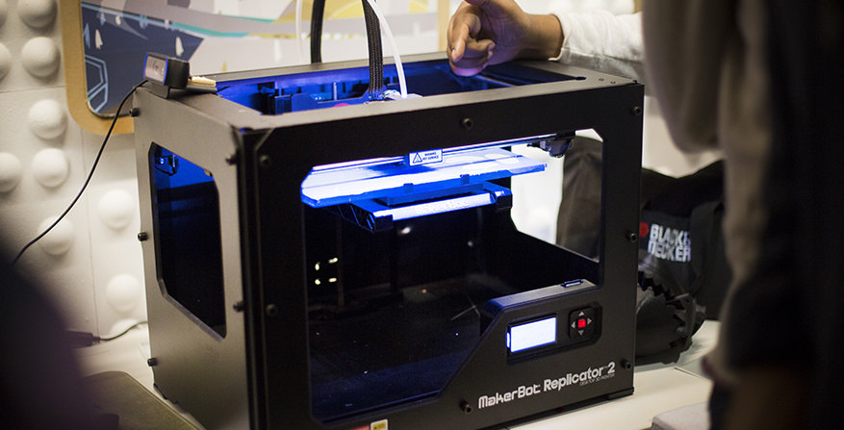

Slide 3
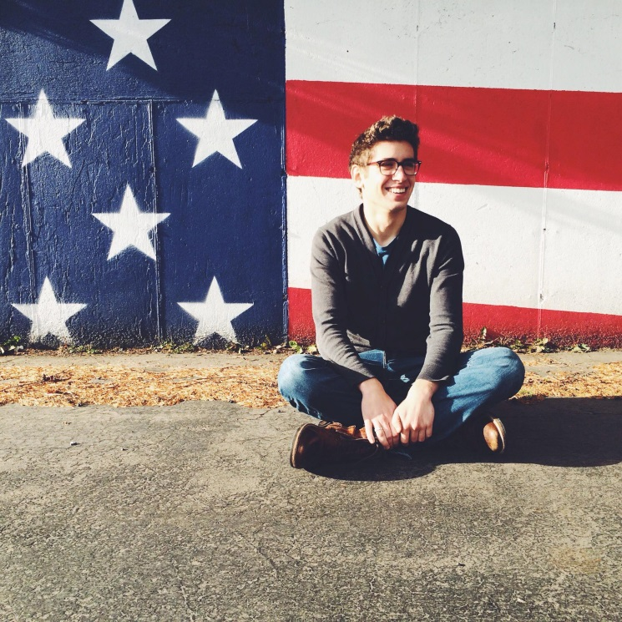
College: iSchool
Major: Information Management
Year: 2nd Year Graduate
About
NEXIS Co-Director
Full-stack developer working on web and data visualization projects
Currently Working On
U Don’t Know Me, a collaborative web-based question and answer game for friends
Billy
Ceskavich

Slide 4
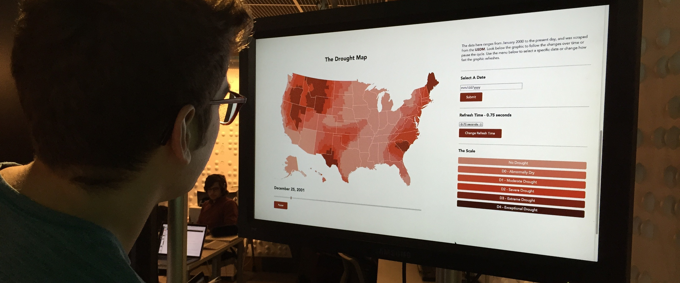

Slide 5
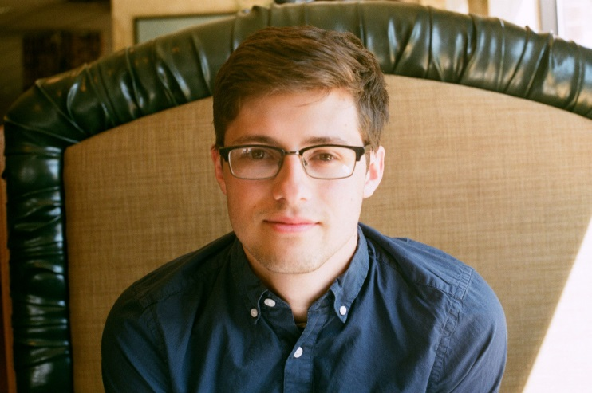
College: iSchool
Major: Information Management & Technology
Year: Senior
About
NEXIS Member
Researcher interested in touchless interfaces
Currently Working On
Building an interactive brainstorming application via touchless technologies
Alexander
Krapf

Slide 6
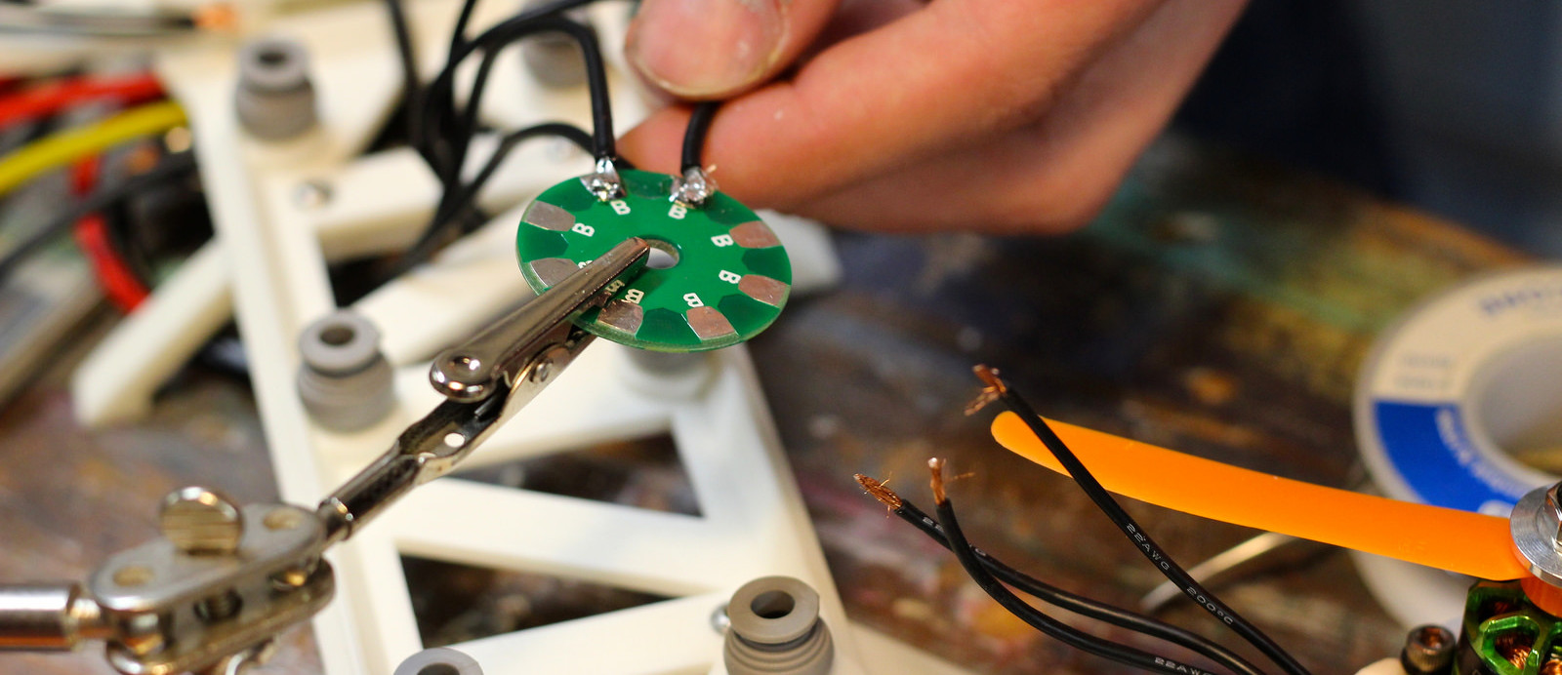

Slide 7
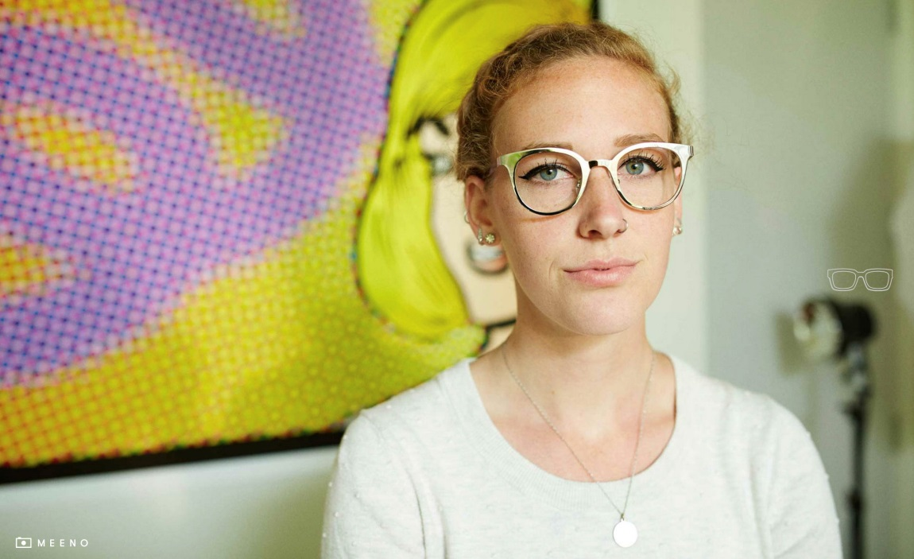
College: Newhouse
Major: Television, Radio, and Film
Year: Senior
About
NEXIS Videographer
Films and produces video content for NEXIS
Natalie
Wiesnet

Slide 9
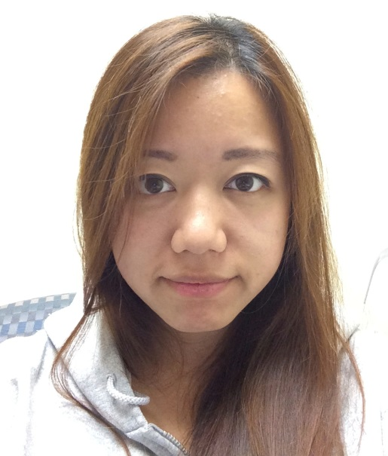
College: iSchool
Major: Information Management
Year: 2nd Year Graduate
About
NEXIS Member
Interested in data visualization
Current Working On
An interactive data visualization examining the refugee crisis in the Middle East and Europe
Reni
Yan

Slide 10
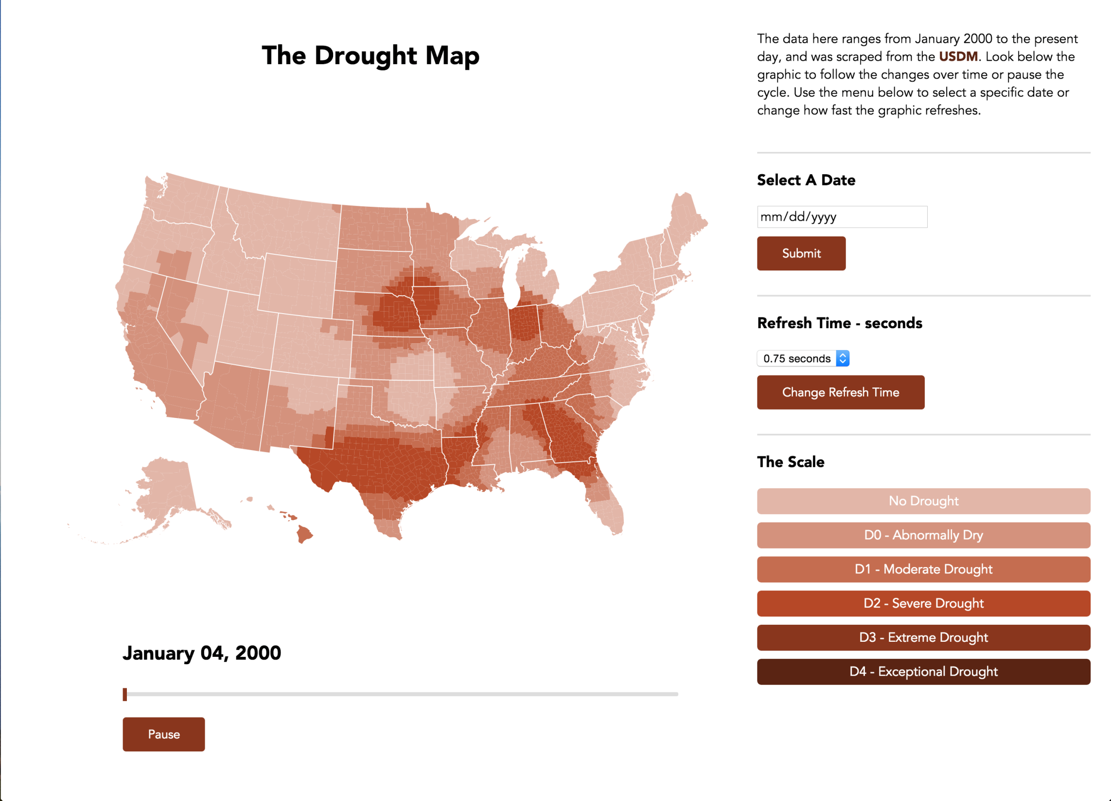

Slide 11
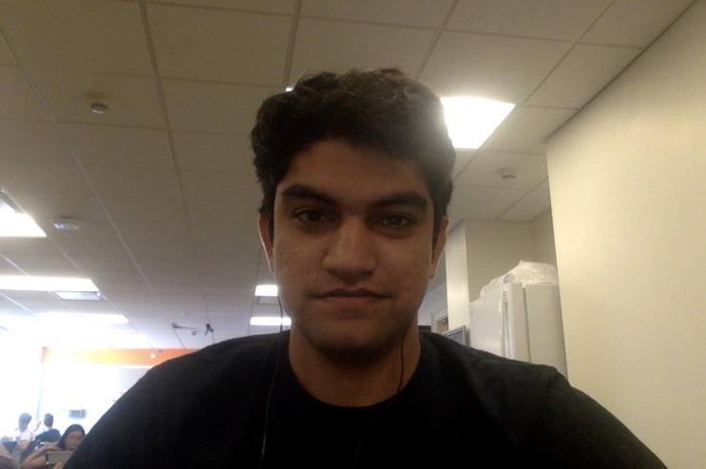
College: iSchool
Major: Information Management
Year: 2nd Year Graduate
About
NEXIS Member
Interested in virtual reality and app development
Current Working On
Creating a VR story using Unity 3D and the Oculus Rift
Prasanna
Kulkarni

