Slide 1

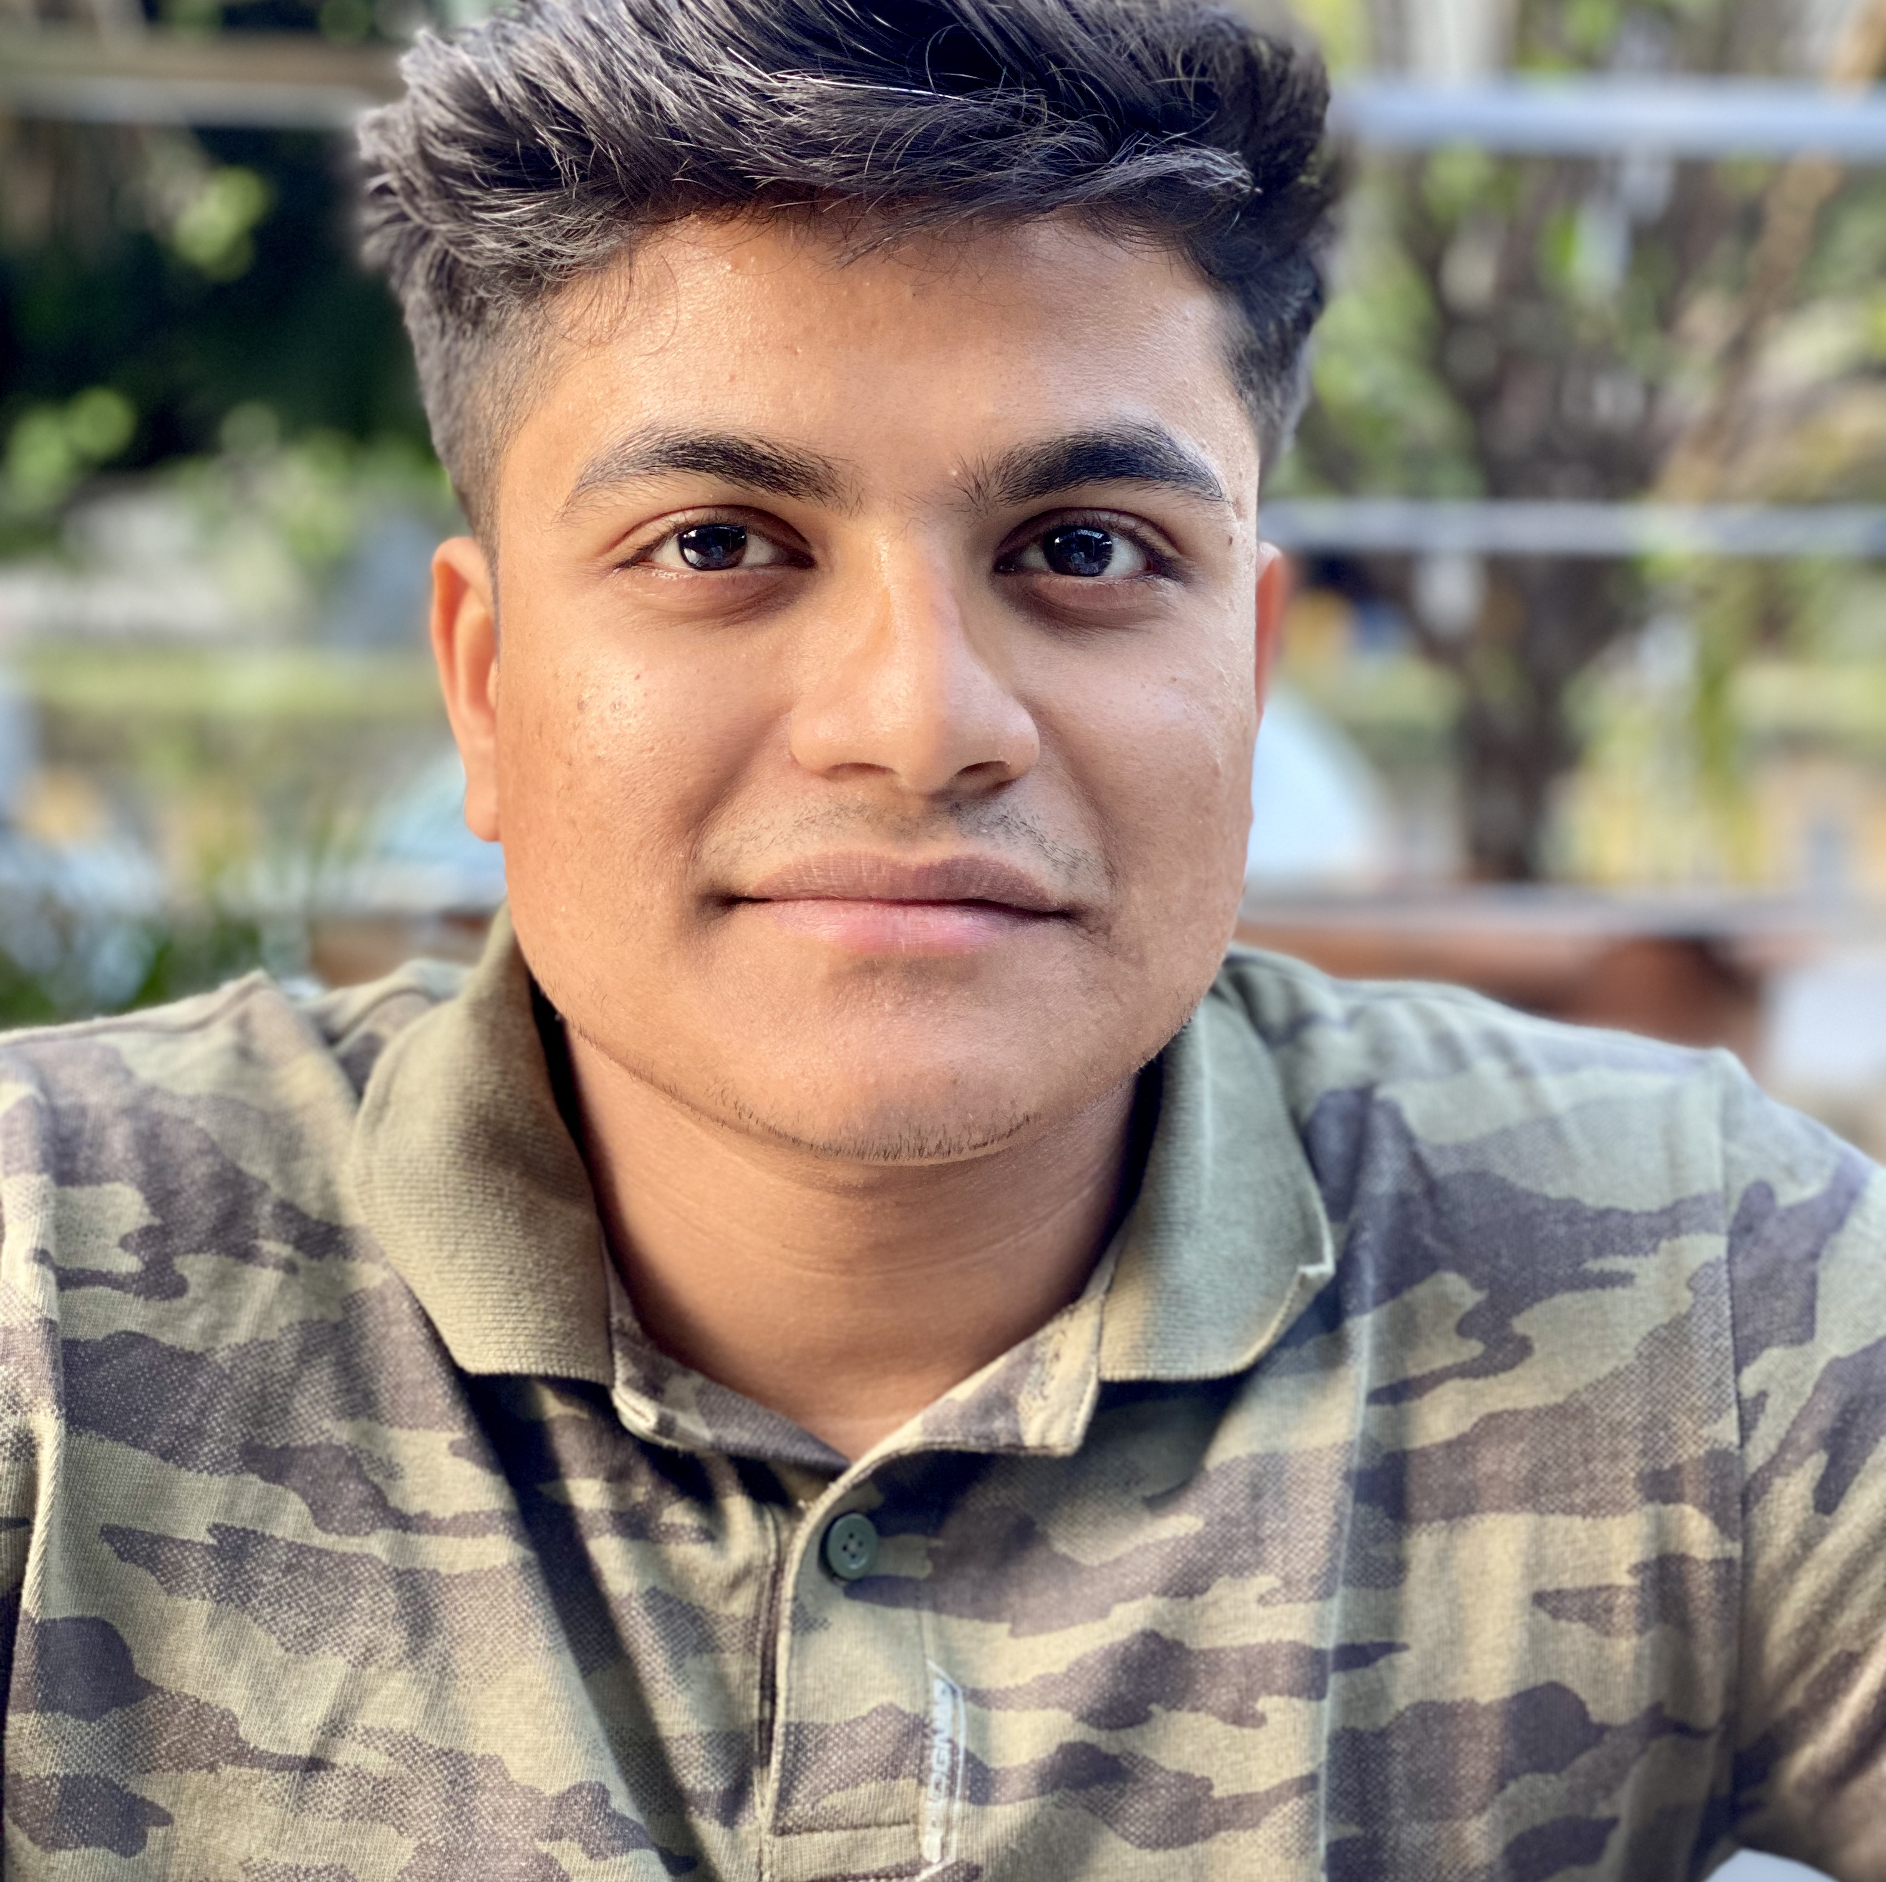
CONGRATULATIONS
Congratulate Ellie Walker for accepting an internship at Campus Ink as a Sales and Design Intern working remote.
Ellie Walker
Congratulate Shreyas Tekawade for accepting an internship at Boehringer Ingelheim as an Information Technology Intern working in their Ridgefield, CT office.
Shreyas Tekawade
School of Information Studies
Syracuse University

