Slide 1
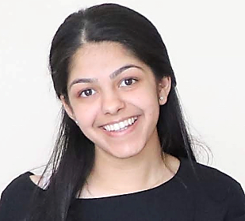
iSchool Screen of Fame
CONGRATULATIONS
Neha Chauhan
Neha Chauhan will be a full-time Technology Risk Consultant at EY located in New York City.
School of Information Studies
Syracuse University

