Slide 1
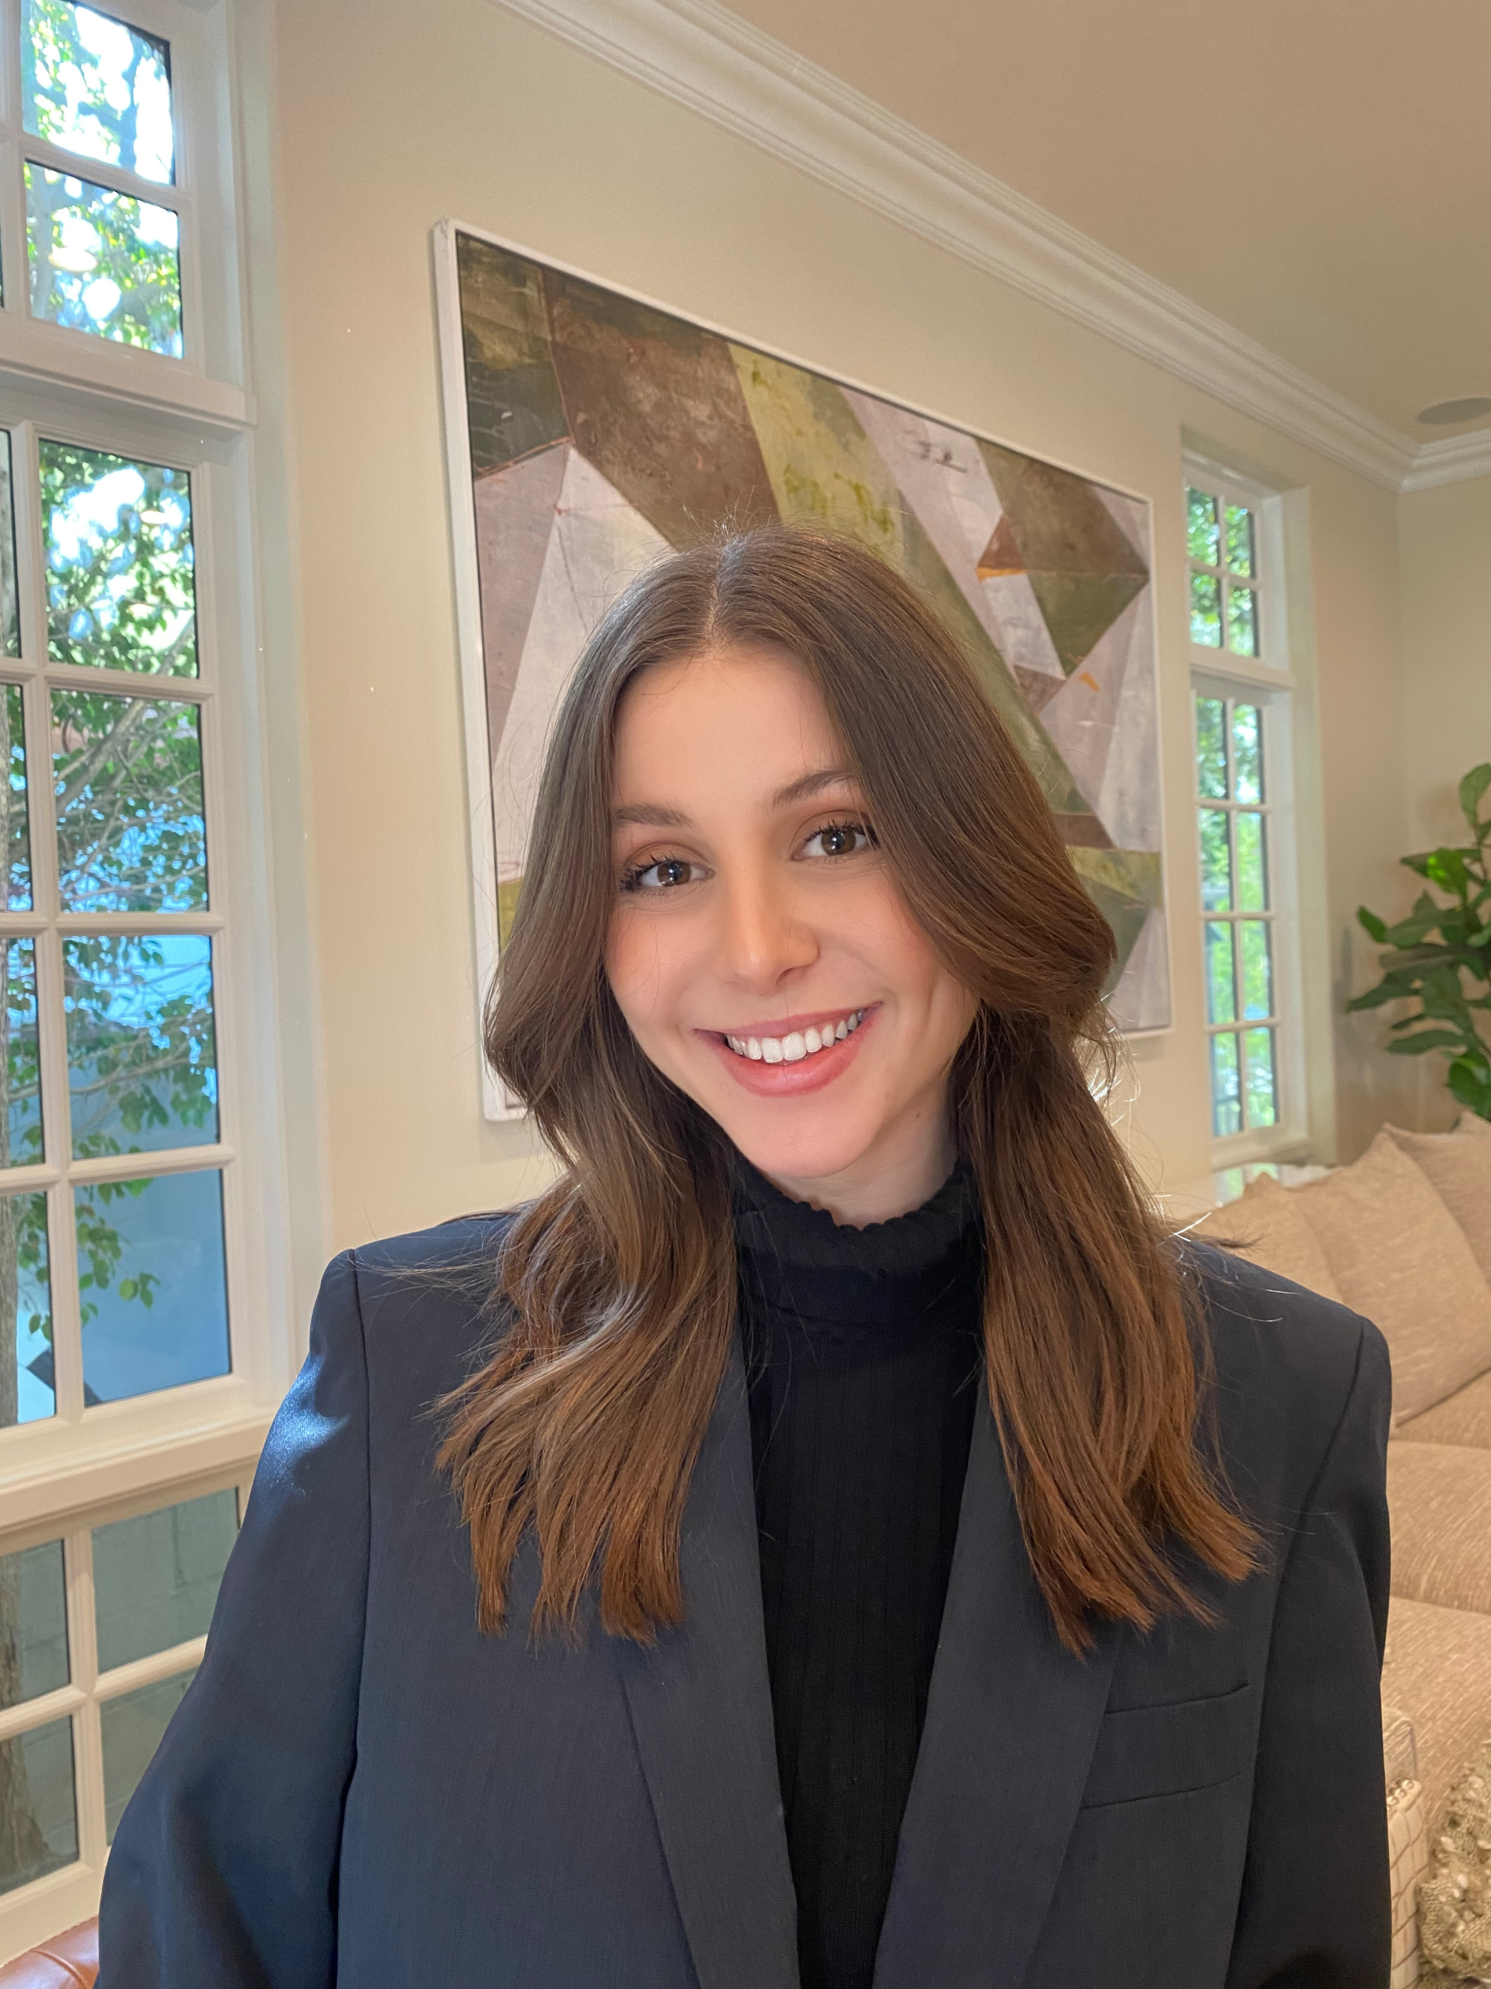
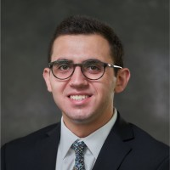
CONGRATULATIONS
Congratulate Sydney Fogelman for accepting a full-time offer at EY as a FSO Technology Consultant in their New York City Hudson Yards office.
Congratulate Steven Sfikas for accepting a full-time offer at EY in the Consultant development Program – Technology Consulting in their Manhattan West, NY office.
School of Information Studies
Syracuse University

