Slide 1
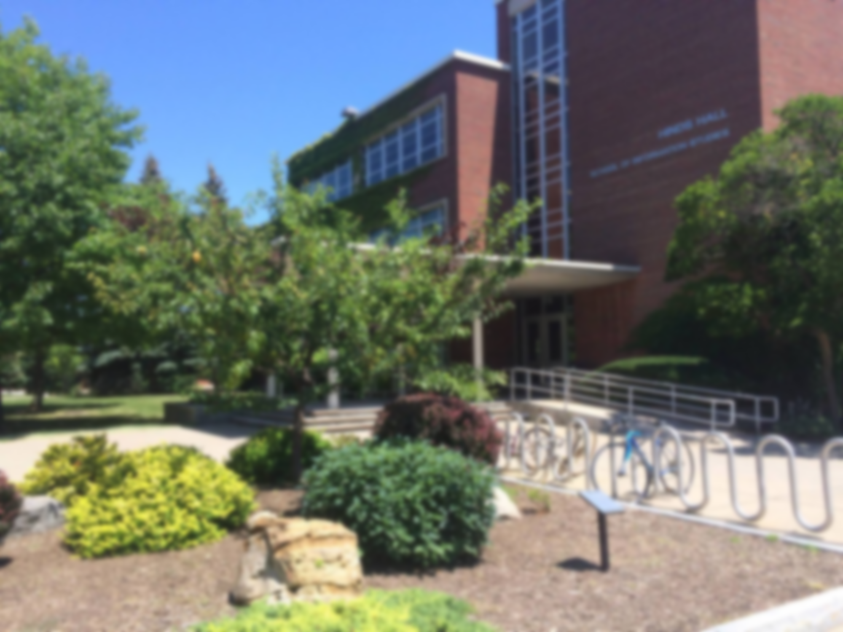



WELCOME TO STUDENT AND CAREER SERVICES
Wishing all new and returning students a successful semester!
School of Information Studies
Syracuse University

