Slide 1
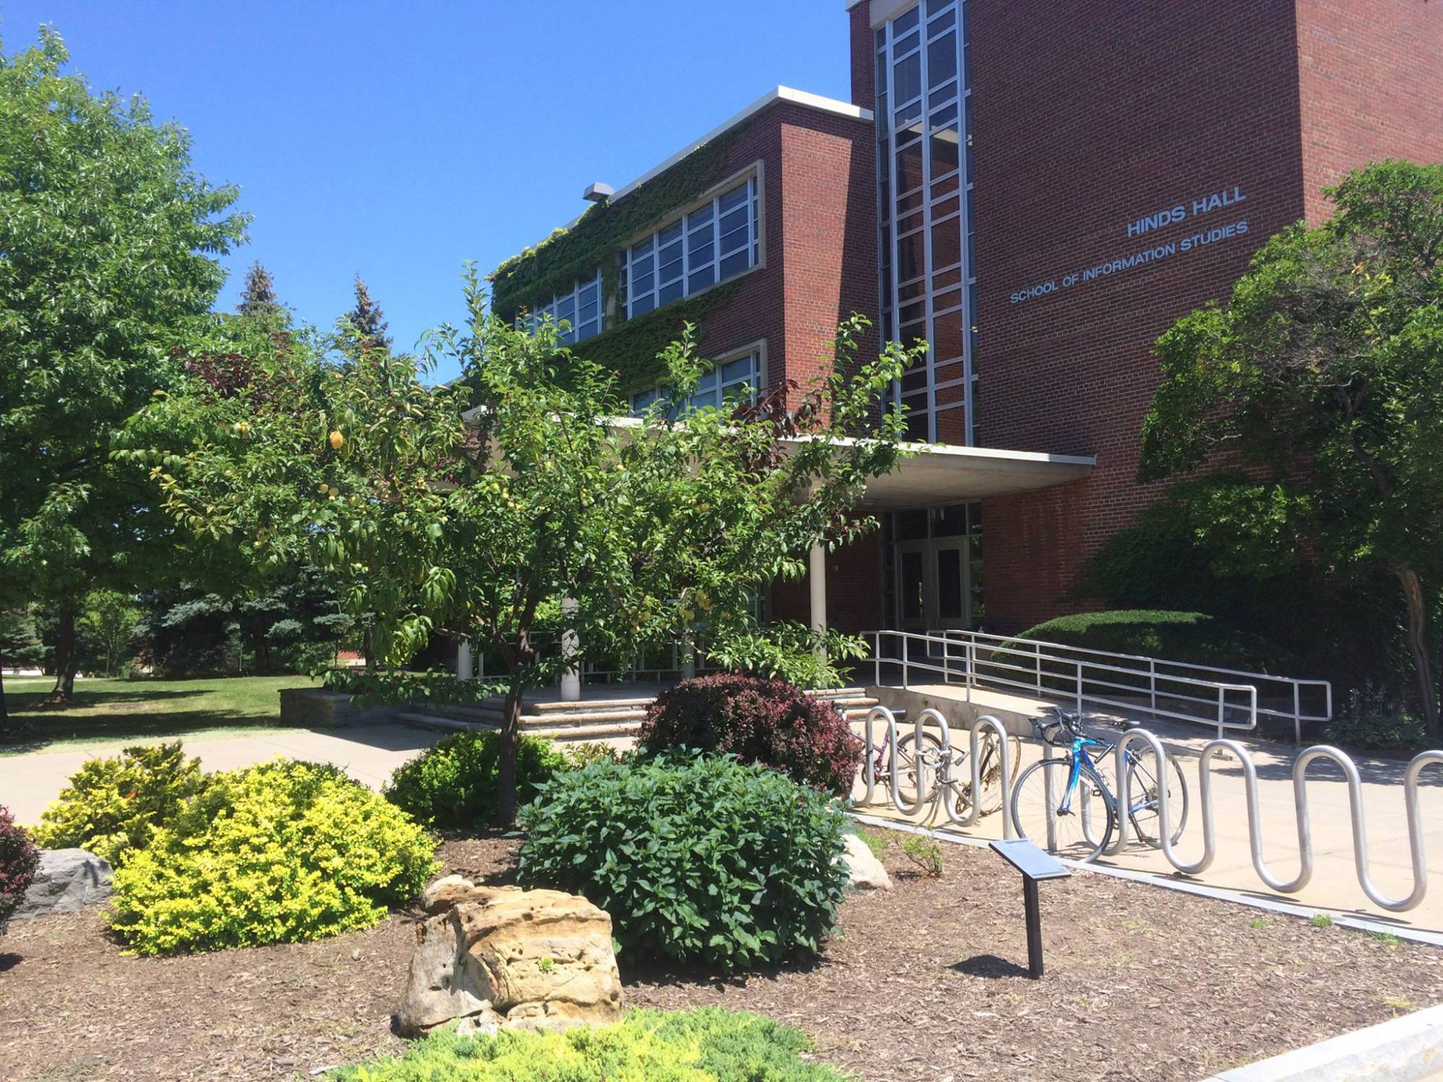
WELCOME TO STUDENT AND CAREER SERVICES
School of Information Studies
Syracuse University

