Slide 1
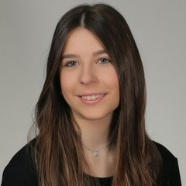
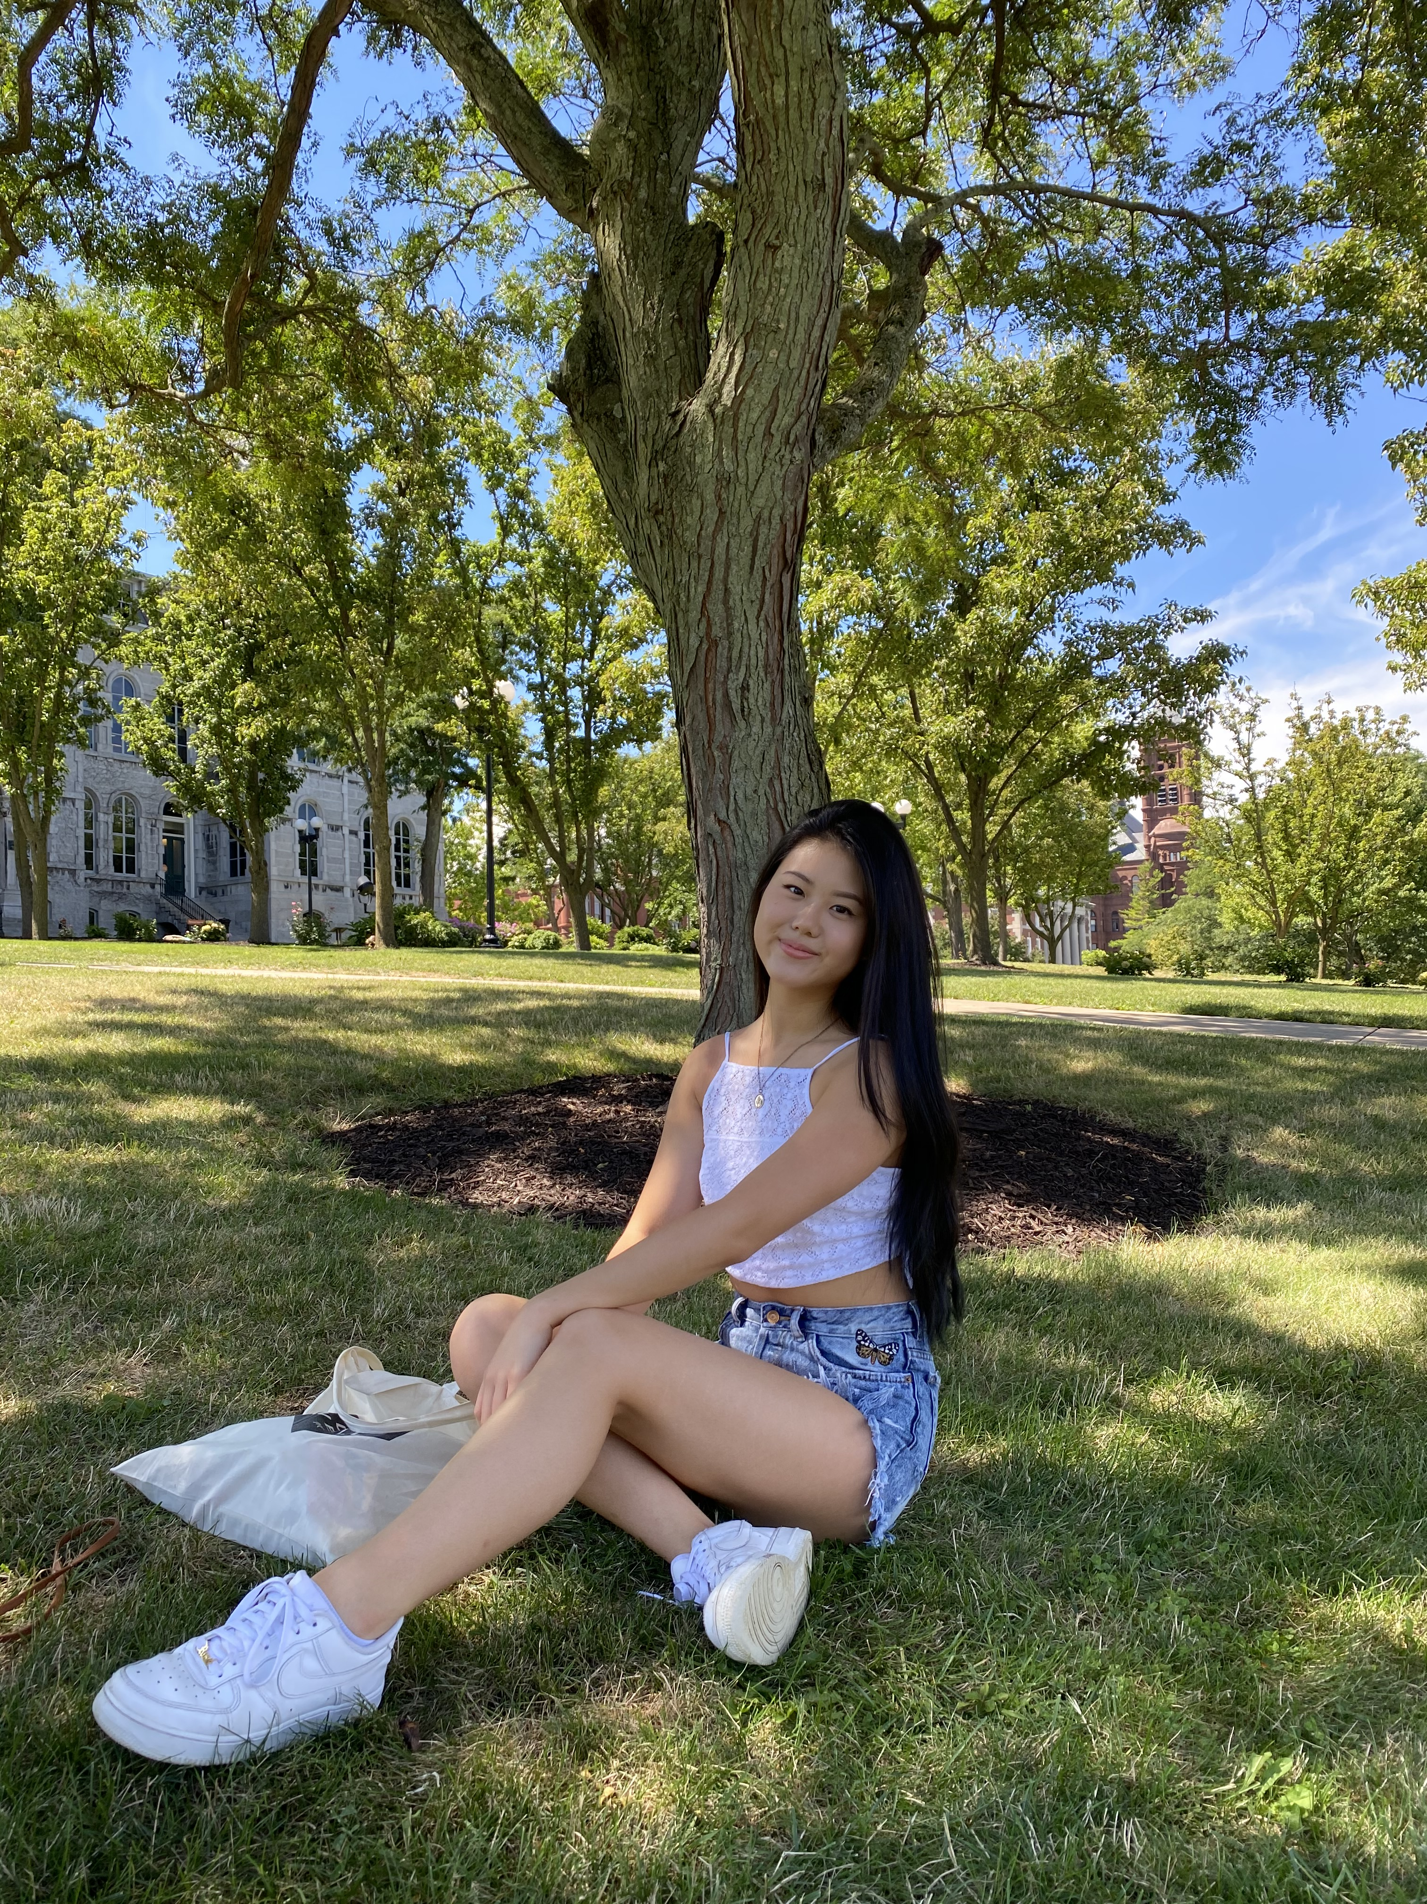
CONGRATULATIONS
Congratulate Tyler Weiss for accepting a full-time offer at EY LLP as a Technology Consultant in their New York City office.
Congratulate Eileen Lee for accepting a full-time offer at KPMG as an Enterprise Solutions – Workday Advisory Associate in their Lexington Ave, NY office.
School of Information Studies
Syracuse University

