Slide 1
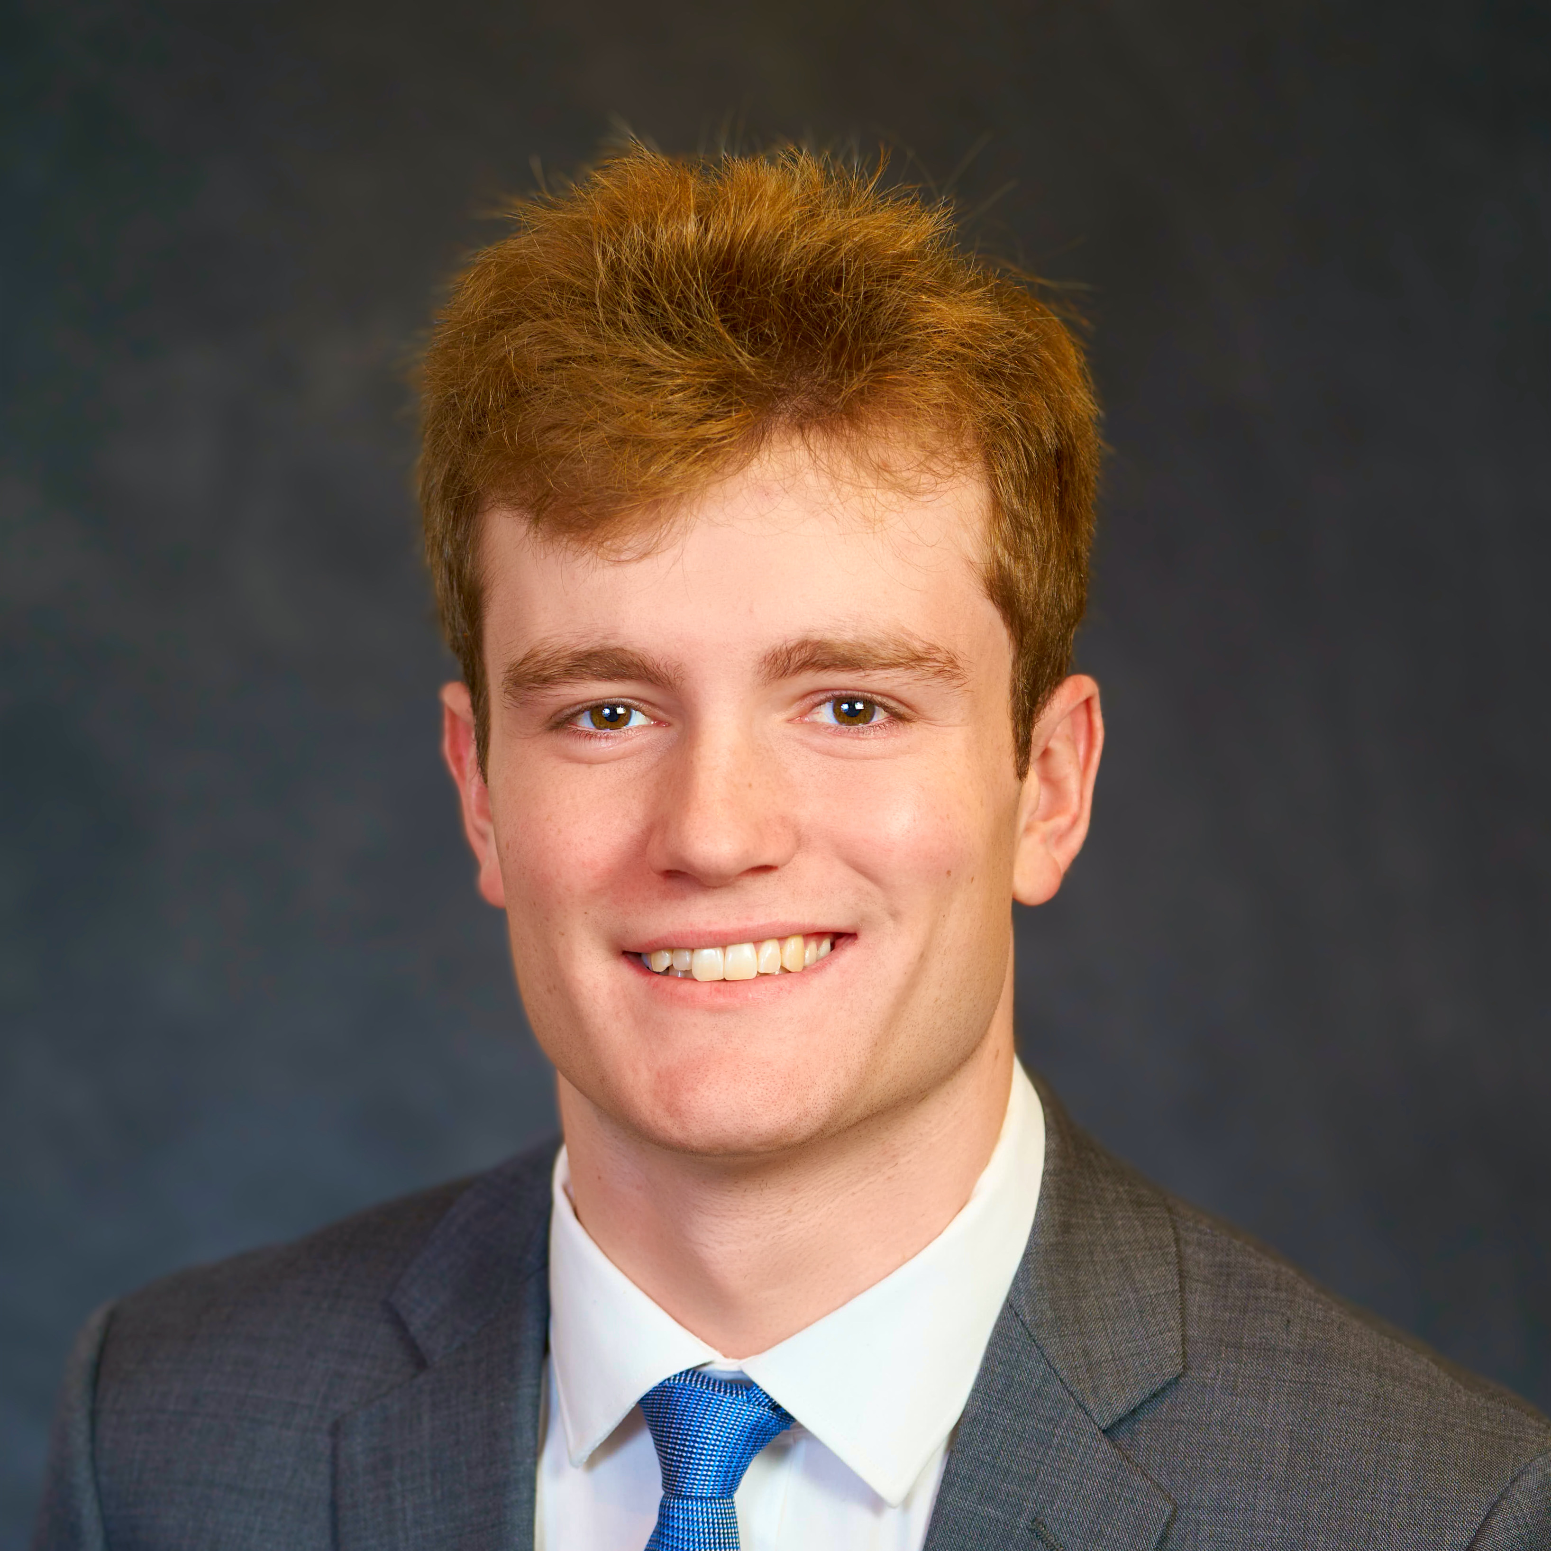
CONGRATULATIONS
Congratulate Wesley Stocken for accepting an internship at C&S Wholesale Grocers as a C&S Wholesale Grocers Procurement Intern working in their Keene, NH office.
Wesley Stocken
Congratulate Kerry Spencer for accepting an internship at Bank of America as a Global Operations Summer Analyst working in their Jacksonville, FL office.
Kerry Spencer
School of Information Studies
Syracuse University

