Slide 1
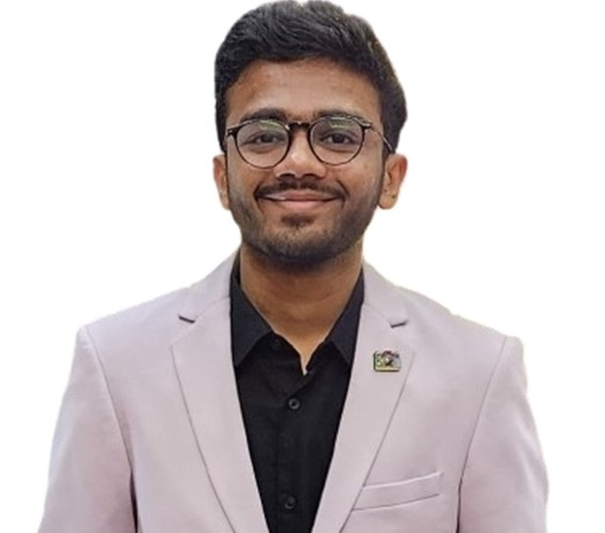
iSchool Screen of Fame
CONGRATULATIONS
Karan Shah
Karan Shah will be a full-time Data Scientist at Wipro located in Louisville, KY.
School of Information Studies
Syracuse University

