Slide 1
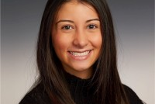
Employee
Congratulations
Congratulate Ava Sobrepera for accepting a full-time offer at EY as a FSO Technology Consultant in their Hoboken, NJ office.
School of Information Studies
Syracuse University

Slide 2
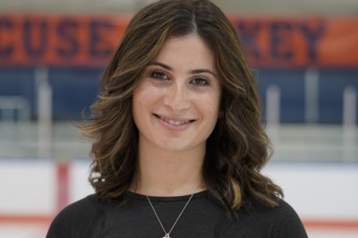
Employee
Congratulations
Congratulate Caroline Katman for accepting a full-time offer at IBM as an Associate Consultant – Data technology Transformation in their Chicago, IL office.
School of Information Studies
Syracuse University

Slide 3
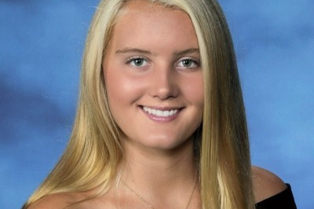
Employee
Congratulations
Congratulate Caroline Oakland for accepting a full-time offer at RSM US LLP as a Consultanting Associate in their New York City office.
School of Information Studies
Syracuse University

Slide 4
Concentration: Data Analytics
Potential Jobs:
      Data Analysis and Quality Specialist
      Data Analyst
      Data Engineer
      Data Implementation Analyst
      Data Mining Analyst
      Data Modeler
      Data Processor
      Data Scientist
      Data Specialist
      Data Visualization Designer
      Database Administrator
      Database Analyst
      Database Management Specialist
      Database Software Engineer
      SQL/Business Intelligence Analyst
      Product Data Analyst
Average Starting Salary: $76,000
Learn more at [ischool.syr.edu]

Slide 5
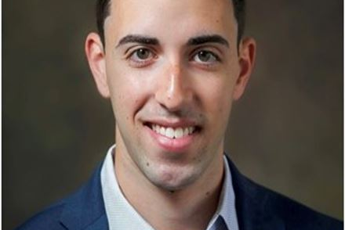
Employee
Congratulations
Congratulate Davis Horowitz for accepting a full-time job offer Deloitte as a PMO Apprentice in their Global Digital Application Studios program located in Chicago.
School of Information Studies
Syracuse University

Slide 6
Concentration:
Digital Retail Strategies
Potential Jobs:
      Marketing Analyst
      Digital Data Analyst
      Digital Imaging Assistant
      Digital Marketing Analyst
      Digital Operations
      Digital Strategy Manager
Average Starting Salary: $60,000
Learn more at [ischool.syr.edu]

Slide 7

Still Looking for an Internship or Job?
You can book an appointment with
iSchool Career Services
by visiting Handshake
Learn more at [syr.joinhandshake.com]

Slide 8

Did you land a summer internship?
…Are you looking to earn academic credit?
Ask to speak with
Kathy Benjamin
and she can help you register for internship credit.
(no retroactive internship credit can be earned)

Slide 9
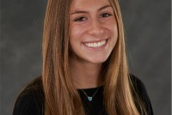
Intern
Congratulations
Congratulate Jenna Bresalier for securing an internship with KPMG as a Cyber Security Consultant for Summer 2022.
School of Information Studies
Syracuse University

Slide 10
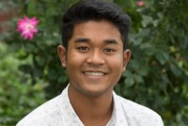
Employee
Congratulations
Congratulate Max Flanagan for accepting a full-time offer at IBM as an Associate Consultant in their New York City office.
School of Information Studies
Syracuse University

Slide 11
Concentration:
Networking & Cloud
Potential Jobs:
      IT Administrator
      IT Analyst
      IT Applications Analyst
      IT Applications and System Engineer
      IT Business Analyst
      IT Consultant
      IT Coordinator
      IT Support Assistant
      IT Technician
      Network Engineer
      Network Support Engineer
Average Starting Salary: $62,500
Learn more at [ischool.syr.edu]

Slide 12
Concentration:
Project Management
Potential Jobs:
      IT Program Manager
      IT Project Specialist
      IT Risk Advisor
      Jr. IT Project Manager
      Scrum Master
      Project Assistant
      Project Associate
      Project Coordinator
      Project Manager
      Project Portfolio Manager
      Project Specialist
      Product Manager
Average Starting Salary: $62,500
Learn more at [ischool.syr.edu]

Slide 13
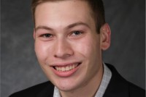
Employee
Congratulations
Congratulate Ross Geffner for accepting an offer with EY as a Technology Consultant in their New York City office.
School of Information Studies
Syracuse University

Slide 14
Concentration:
Information Security
Potential Jobs:
      IT Specialist (INFOSEC – Cyber Security)
      Network Security Manager
      Senior Analyst – IT Security
      Security Analyst
      Security Consulting Analyst
      Security Services Consultant
      Security Specialist
      Cyber Analyst
      Cyber Engineer/Analyst
      Cyber Security Analyst
      Cyber Security Compliance Specialist
      Cyber Security Consultant
      Cyber Security Engineer
Average Starting Salary: $84,500
Learn more at [ischool.syr.edu]

Slide 15
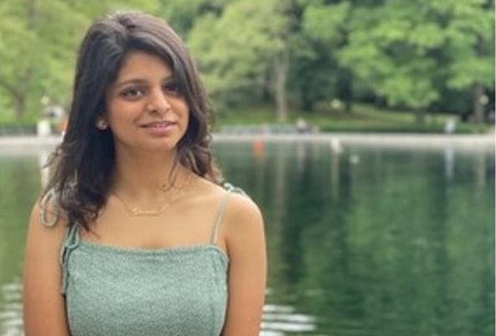
Intern
Congratulations
Congratulate Shruti Kadam for accepting a summer internship at PwC as a Cyber Privacy & Forensics Technology Consulting Intern in their New Yor City office.
School of Information Studies
Syracuse University

Slide 16
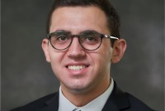
Employee
Congratulations
Congratulate Steven Sfikas for accepting a full-time offer at EY in the Consultant development Program – Technology Consulting in their Manhattan West, NY office.
School of Information Studies
Syracuse University

Slide 17
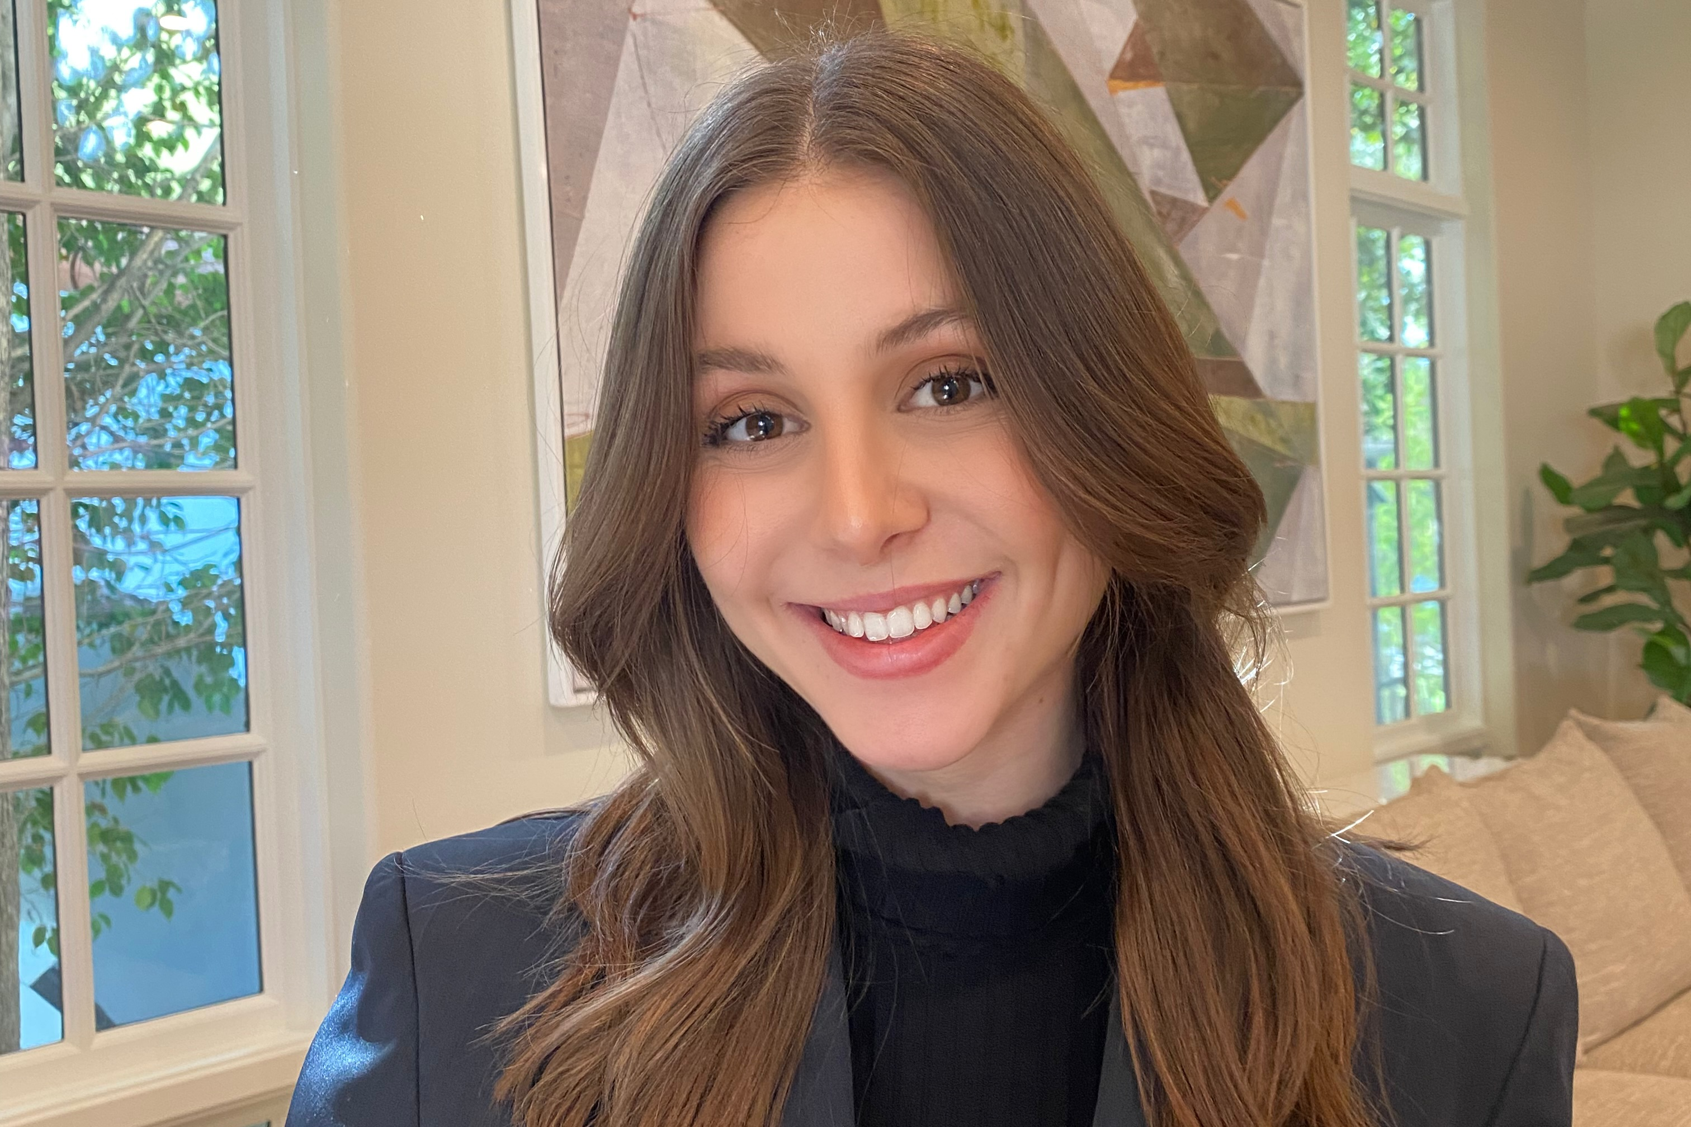
Employee
Congratulations
Congratulate Sydney Fogelman for accepting a full-time offer at EY as a FSO Technology Consultant in their New York City Hudson Yards office.
School of Information Studies
Syracuse University

Slide 18
Concentration:
Web Design & Management
Potential Jobs:
      Marketing Web Producer
      Mobile/Web designer and developer
      New Media Operations Manager
      Web Analyst
      Web Developer
      Web developer/Consultant
      Front-End Developer
      Front-End Web developer
Average Starting Salary: $60,000
Learn more at [ischool.syr.edu]

